Slide 1
Data Visualization
Using Matplotlib

Slide 2
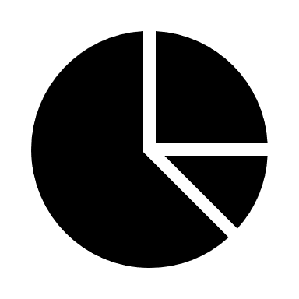
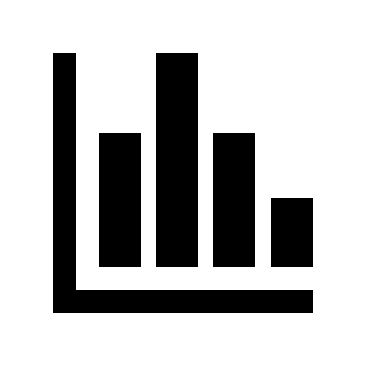
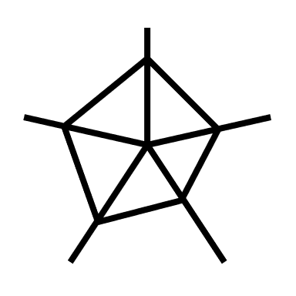
Matplotlib
Visualization library

Slide 3
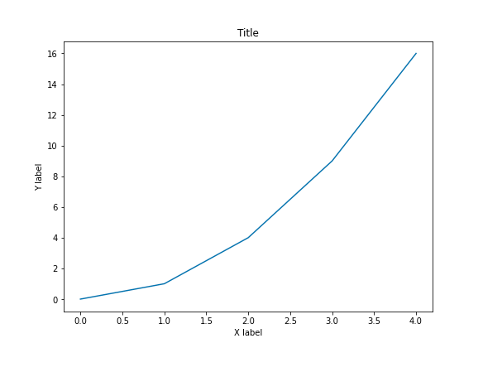
Figure
Axes
X axis
Y axis

Slide 4

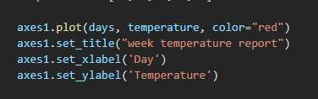
Steps
1) Import the matplotlib library.
2) Create a Figure object and an Axes object for each plot.
3) Use Axes object methods to customize your plot.

